Slide 1
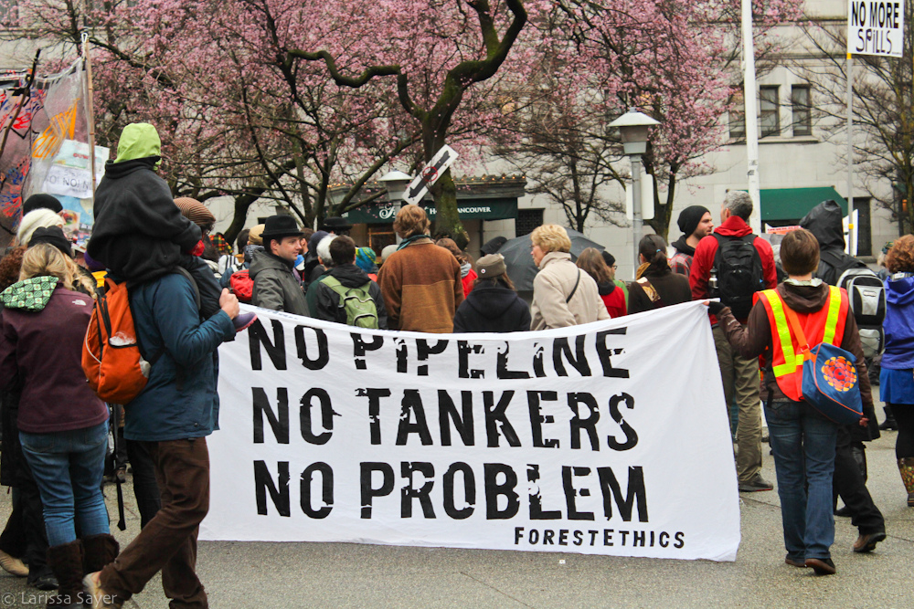
Pipeline Resistance as Political Strategy:
“Blockadia” and the Future of Climate Politics
George Hoberg, UBC, for CPSA 2015

Slide 2
“You are aware, aren’t you, that Enbridge has to get approvals from the feds and province, Enbridge has to get all the affected communities and First Nations on side, and then Enbridge has to build approximately 1,173 km of pipeline through some of the most difficult terrain ever attempted. In contrast, all we, the opposition, have to do is to stop one inch.”
Will Horter, Dogwood Initiative to Pat Daniels, then CEO of Enbridge

Slide 3
Dilemma
Does the strategy that has proven so effective at strengthening the climate movement threaten the required clean energy transition?

Slide 4
outline
Grand challenge of climate mobilization
Strategies for change
Blockadia as emergent solution
Oil sands pipelines case study
Strategic perils for clean energy transition
Can process or structure save us?

Slide 5
Why is it so hard to mobilize on climate change?

Slide 6
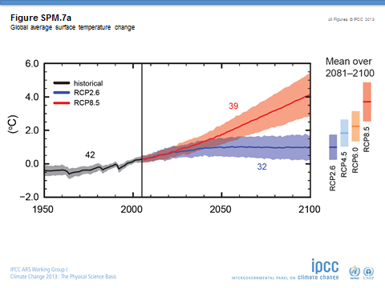
1. Wicked problem structure
Uncertainty re the timing, magnitude of impacts
spatial inconsistency – costs of action local, benefits global
temporal inconsistency – costs of action now, benefits in future

Slide 7

2. Psychological barriers
Abstractness
Optimism – uncertainty breeds wishful thinking
Short-termism
“You almost couldn’t design a problem that is a worse fit with our underlying psychology.”
Anthony Leiserowitz, Yale University
Notes:
Leiserowitz quote from http://www.nytimes.com/2012/07/22/opinion/sunday/were-all-climate-change-idiots.html?_r=0

Slide 8
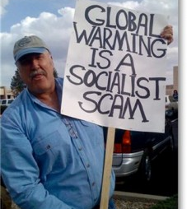
3. Economic Opposition
Privileged position of business
Powerful business opponents (private and state-owned)
Consumer/voter resistance to increased prices
  Pielke’s Iron Law of climate politics: policies that restrict economic growth are doomed to fail
Conservative social movement
Notes:
Roger Pielke, Jr. The Climate Fix

Slide 9
4. Dysfunctional Governing Institutions
UNFCC – Consensus required from all countries – recipe for stalemate
US: majority interest in action thwarted by rules requiring extraordinary majorities
Canada: electoral + party system has granted governing power to the 40% on the conservative end of the spectrum

Slide 10
Strategies for Change
Overcoming Barriers
Localize (tankers)
Ally with more powerful (First Nations)
Exaggerate threat (carbon bomb)
Concretize (pipelines)
Make threat more immediate (extreme weather)
Create villains (divestment)

Slide 11
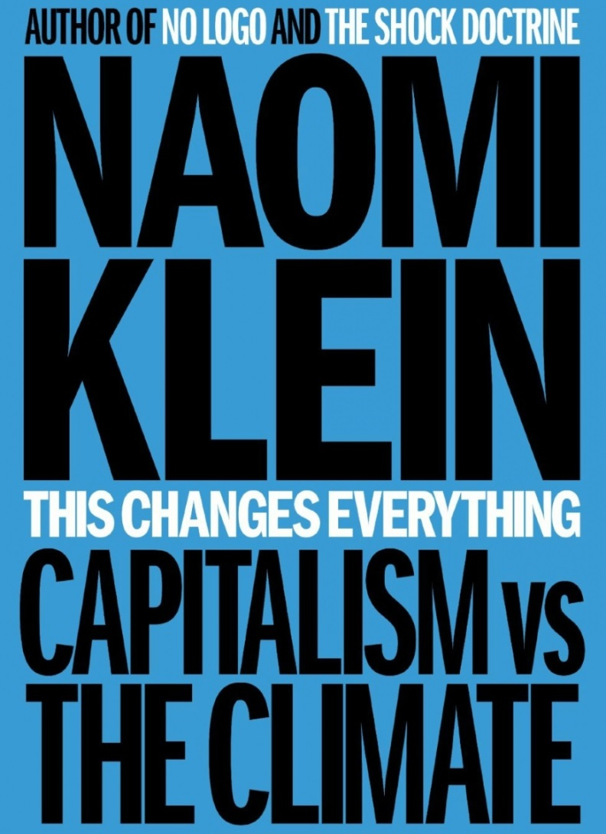
Emergent solution: “Blockadia”
Roving transnational conflict zone
Provoked by “extreme extractivism”
Local resistance movements demanding local control
Strategic advantage: avoids (some) climate mobilization challenges

Slide 12
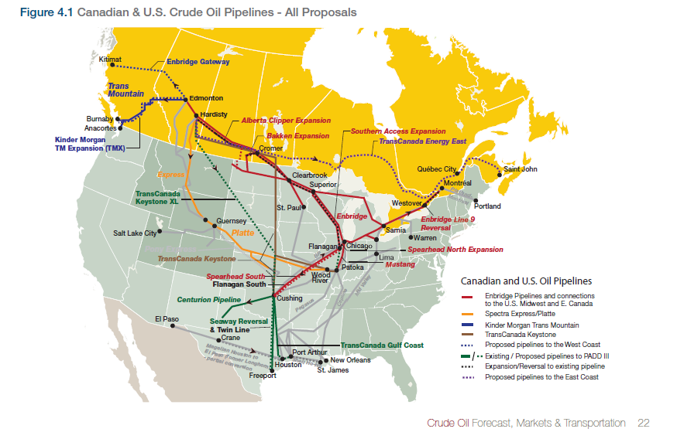
Blockadia Case Study:
Oil Sands Pipeline Resistance

Slide 13
The Four Major Projects
Project | Company | Capacity (bpd) | Location | Status
Keystone XL | TransCanada | 830,000 | Alberta to US Gulf Coast | Awaiting presidential permit
Northern Gateway | Enbridge | 525,000 | Alberta to BC Coast | Approved with conditions
TransMountain Expansion | Kinder Morgan | 590,000 | Alberta to BC Coast | In hearings
Energy East | TransCanada | 1,100,000 | Alberta to Atlantic Canada | Awaiting hearings

Slide 14
Political Risk Factors
The relative power of project opponents is a function of four variables:
whether opposition groups have access to institutional veto points
whether the project can take advantage of existing infrastructure
the salience of place-based, concentrated environmental risks
the geographical separation of risks and benefits
George Hoberg, “The Battle Over Oil Sands Access to Tidewater: A Political Risk Analysis of Pipeline Alternatives,” Canadian Public Policy, Volume 39, No. 3, September 2013, pp. 371-391.

Slide 15
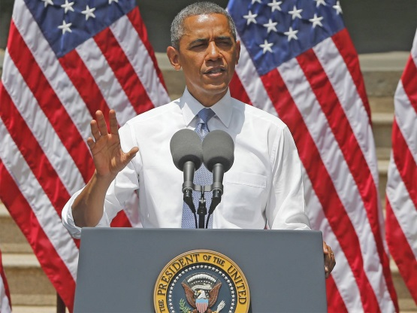
Keystone XL status
Awaiting presidential decision
“Our national interest will be served only if this project does not significantly exacerbate the problem of carbon pollution. The net effects of the pipeline’s impact on our climate will be absolutely critical to determining whether this project is allowed to go forward.”
President Obama, June 25, 2013

Slide 16
Northern Gateway Pipeline
Exhaustive review process that changed Canadian politics
Approved with conditions by Harper government
19 court challenges by First Nations, environmentalists
Virtually all observers believe the project is dead

Slide 17
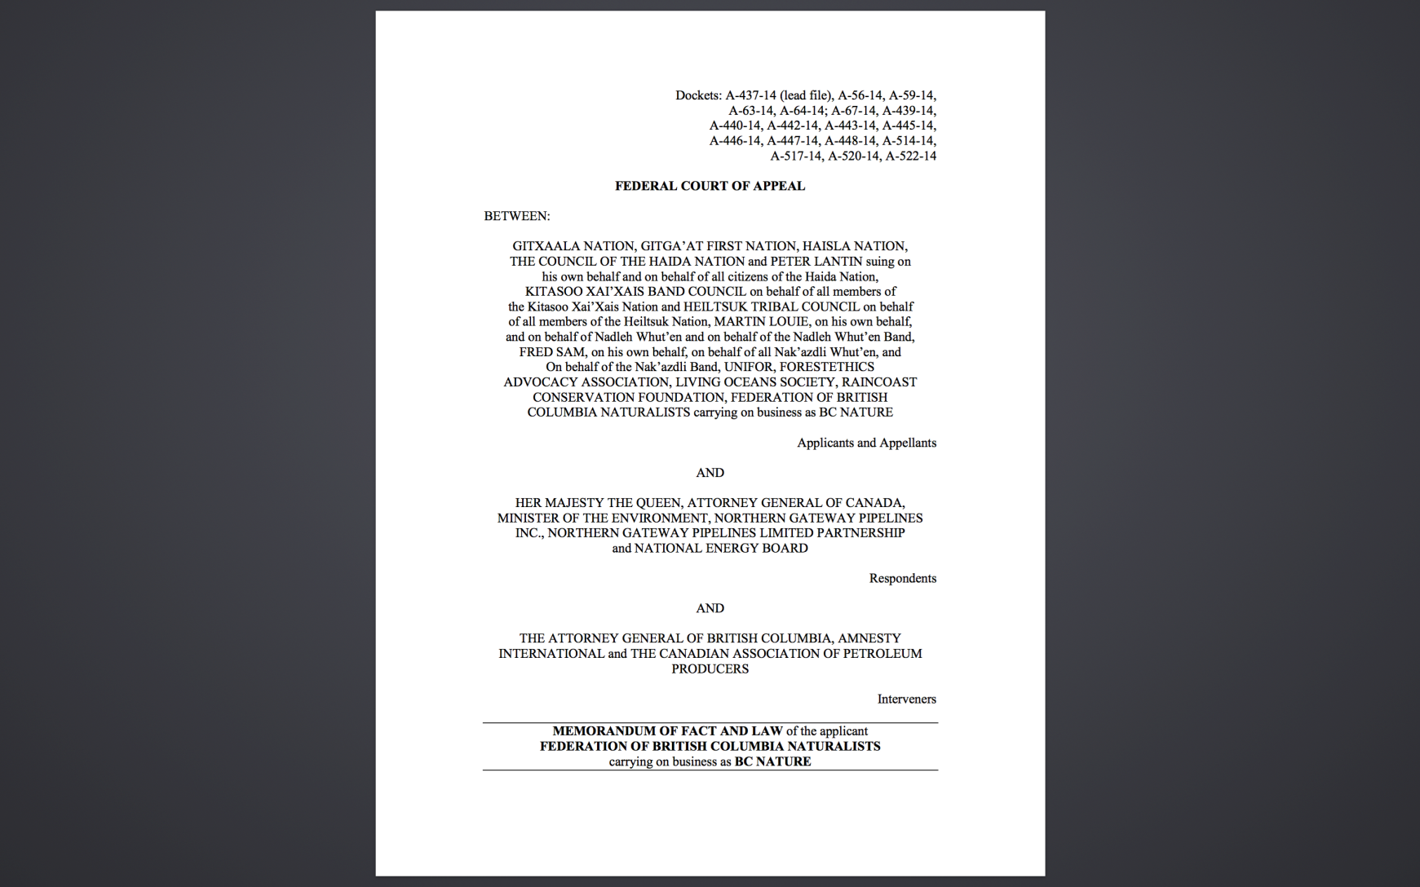
Consolidated Northern Gateway Litigation

Slide 18
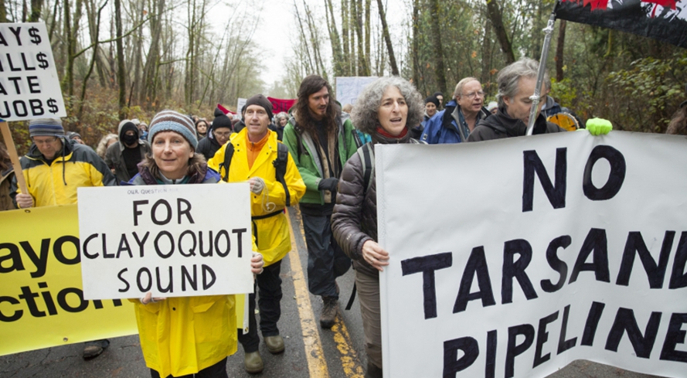
Kinder Morgan

Slide 19
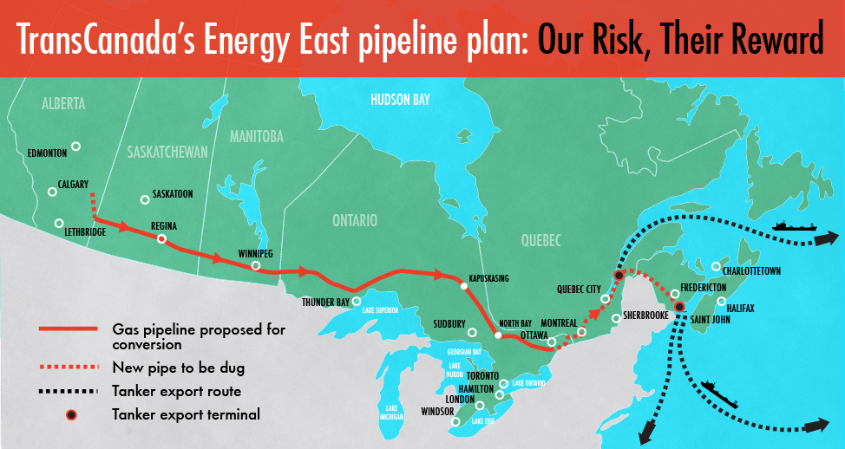
Energy East
From Environmental Defence

Slide 20
Blockadia – Strategic Perils
What happens when place-based risks don’t galvanize resistance?
Energy system transformation requires rapid, massive building of new infrastructure
Institutions (and norms) that give locals authority to block dirty energy give them authority to block clean energy

Slide 21
Keystone XL
State Department EIS
“approval or denial of any one crude oil transport project, including the proposed project, is unlikely to significantly impact the rate of extraction in the oil sands or the continued demand for heavy crude oil at refineries in the United States based on expected oil prices, oil-sands supply costs, transport costs, and supply-demand scenarios” (US Department of State 2014).

Slide 22
Climate framing in pipeline disputes
From Canadian Newstand

Slide 23
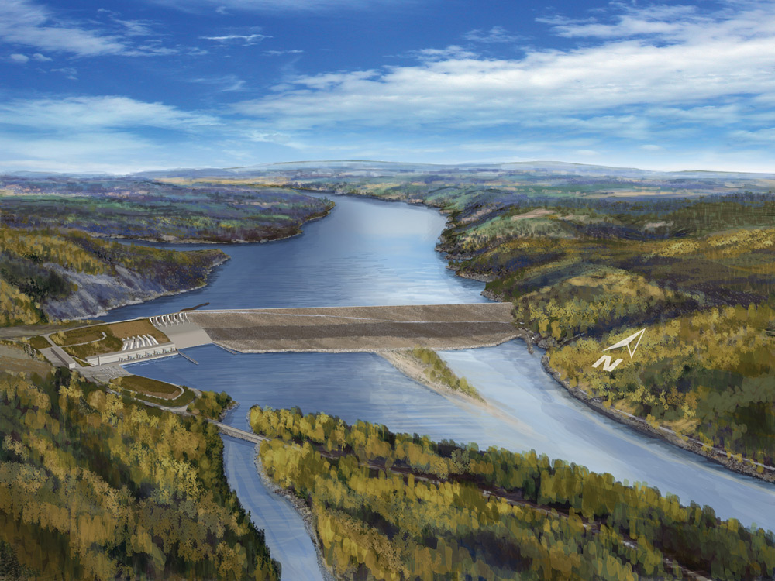
Site C Clean Energy Project

Slide 24
BC groups opposed
Peace Valley Environmental Association
David Suzuki Foundation
Sierra Club of BC
Wilderness Committee
Pembina Institute
LeadNow
BC Sustainable Energy Association
Treaty 8 Tribal Association

Slide 25
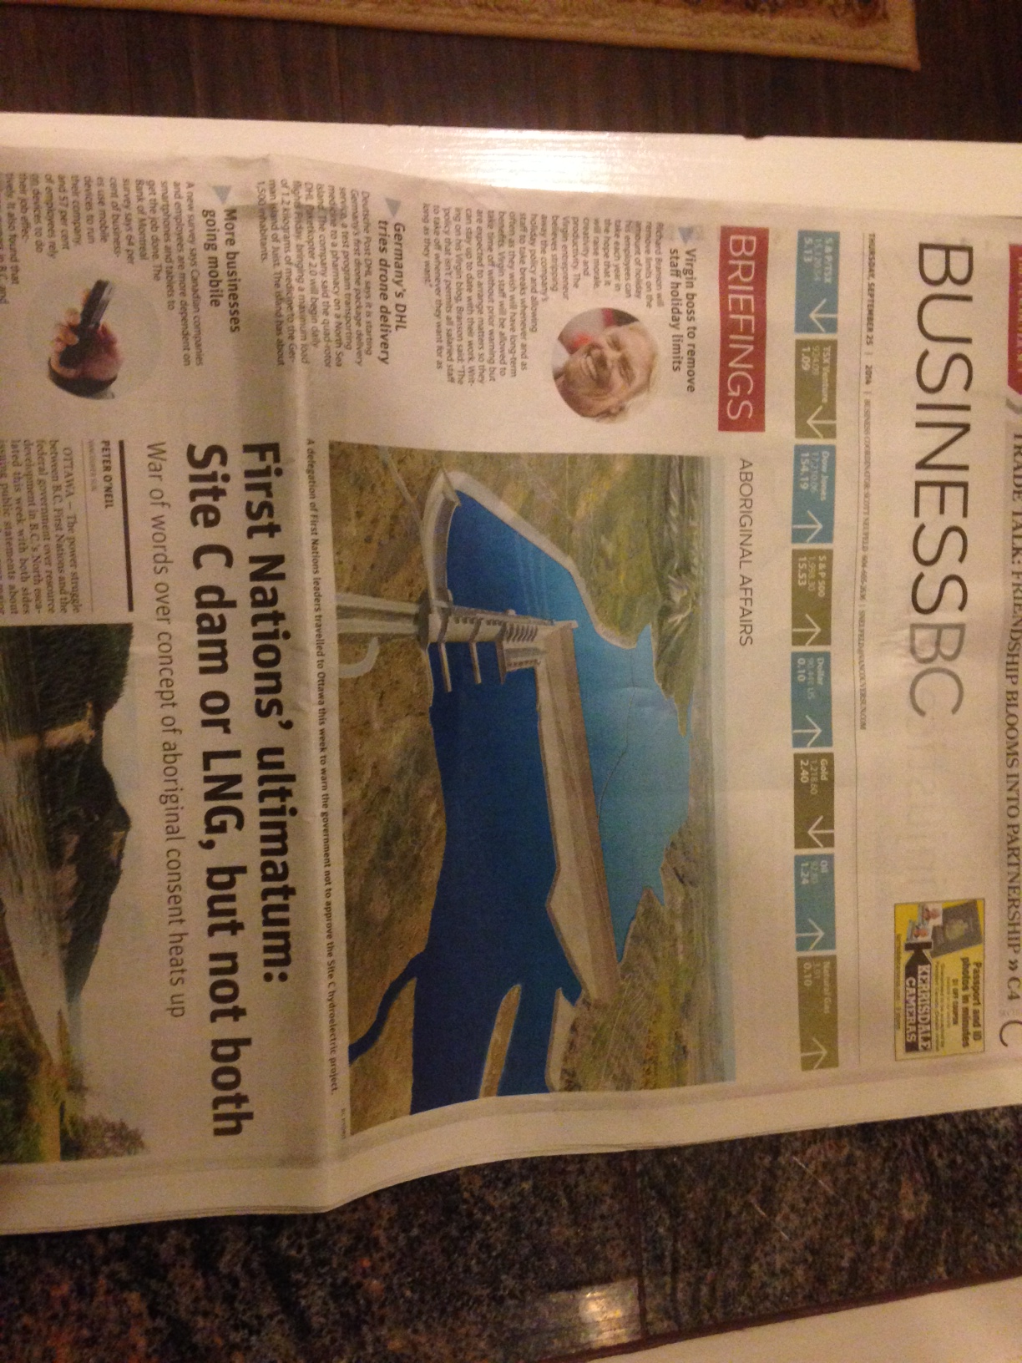

Slide 26
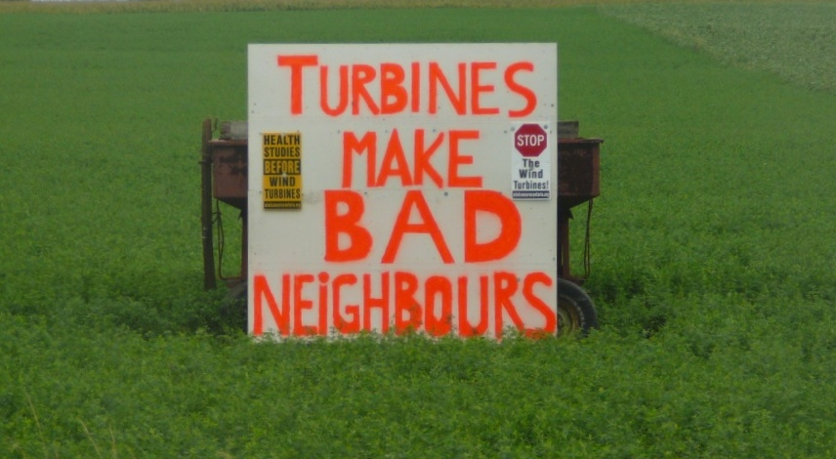
Wind Energy in Ontario

Slide 27
Conclusion: Is there hope in process and structure?
Challenge: sincerely incorporate placed-based concerns without paralyzing siting process
Core issue: should lower levels of government have a veto?
Can activists have “institutional principles”?
Notes:
Role of courts vs elected bodies
Role of different levels of government

Slide 28
