Slide 1
EU Access Agreements for West African Fisheries
ENV1001 – Presentation slides
Milan Ilnyckyj
2015-10-23

Slide 2
Outline
Context
  Marine ecosystem basics
  The global fishing industry
  UNCLOS and international fisheries law
Access agreements
Analysis, questions, and discussion

Slide 3
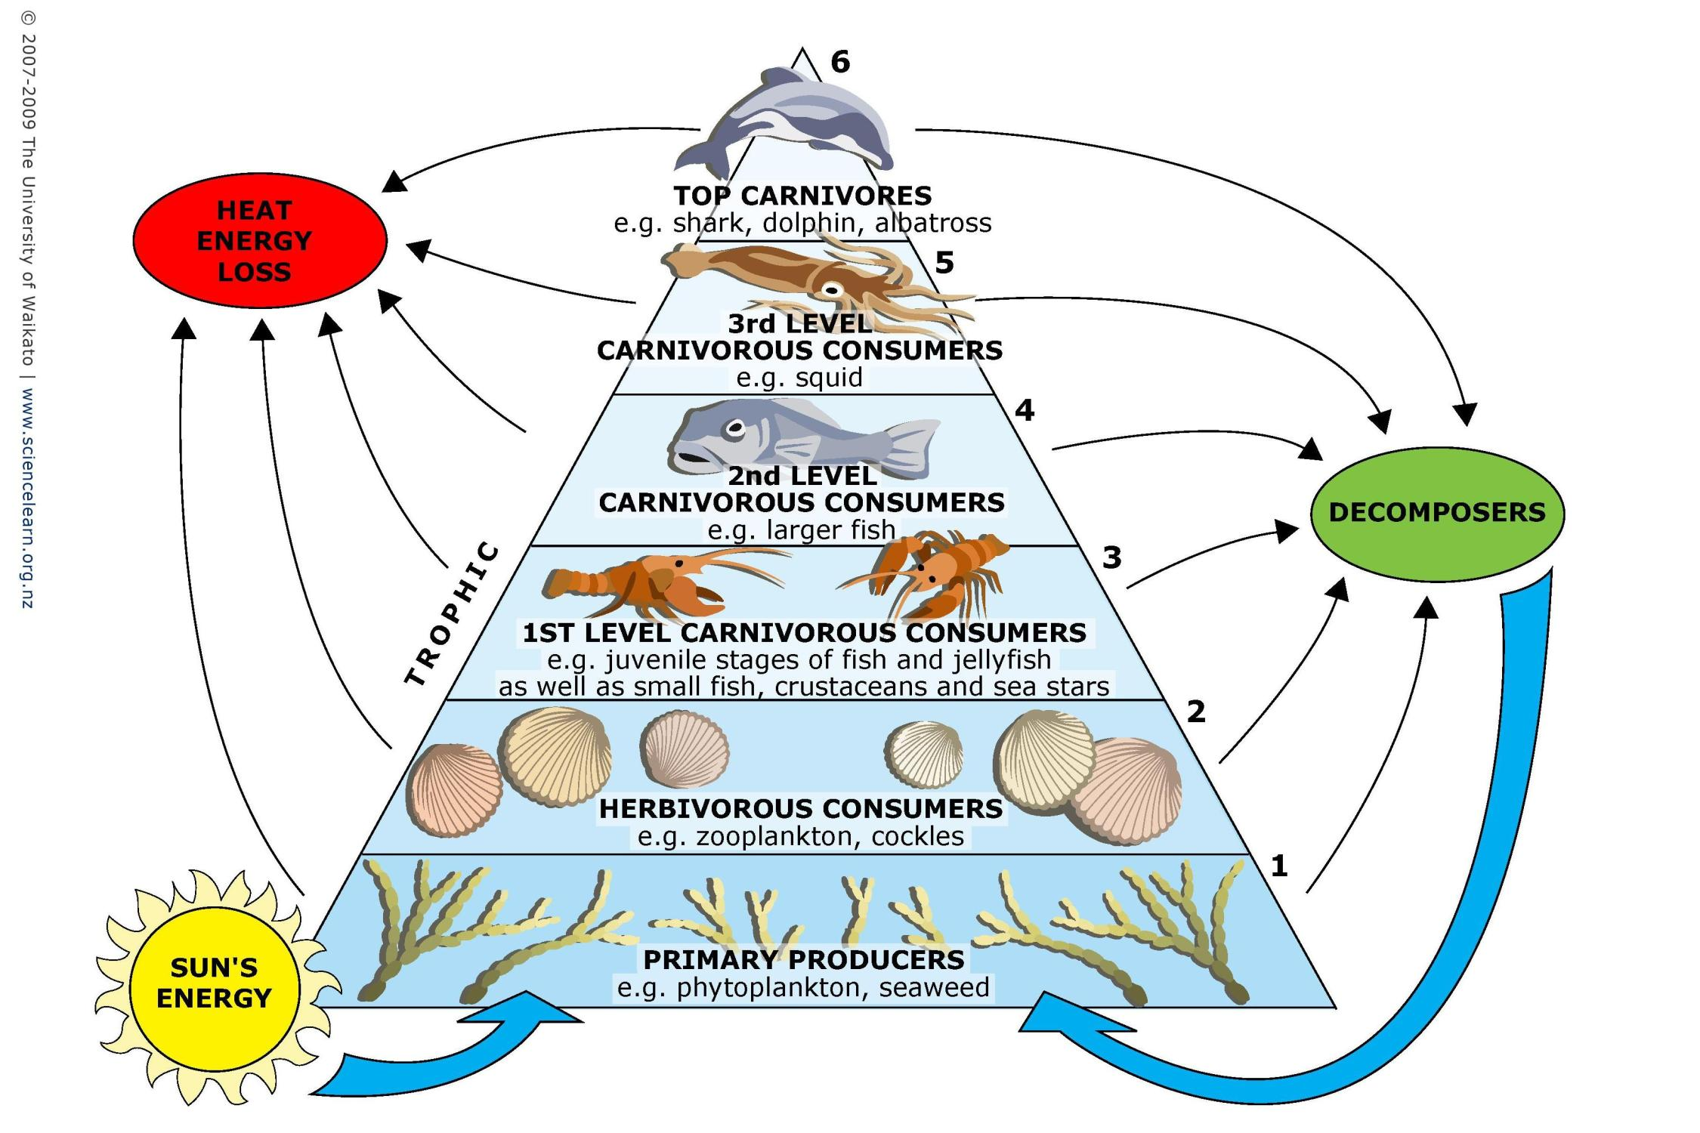
Trophic levels

Slide 4
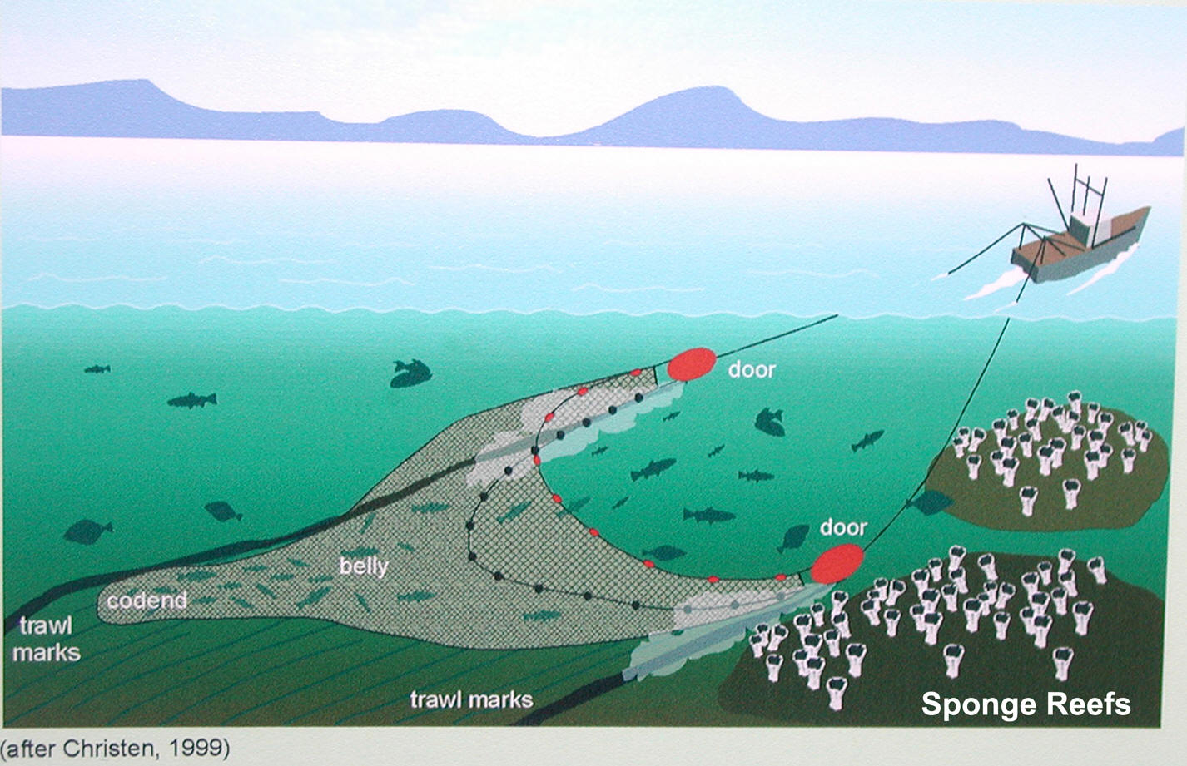
Trawling (1/3)

Slide 5
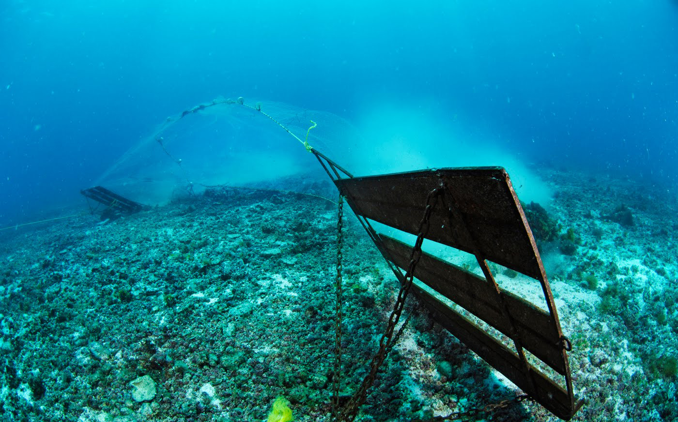
Trawling (2/3)

Slide 6
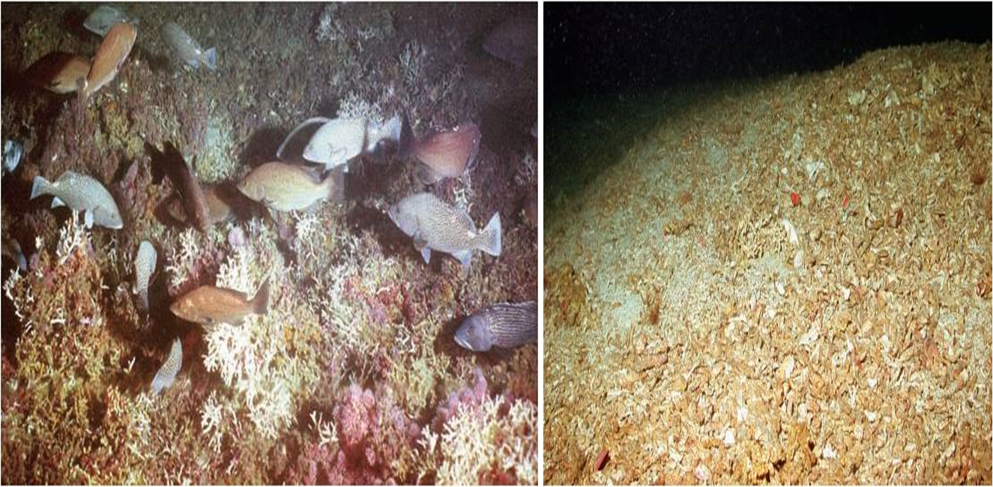
Trawling (3/3)

Slide 7
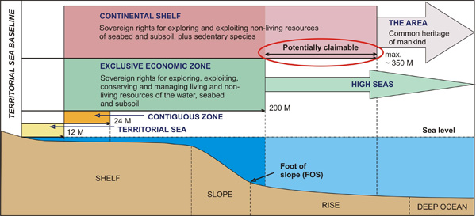
UNCLOS (1994)

Slide 8
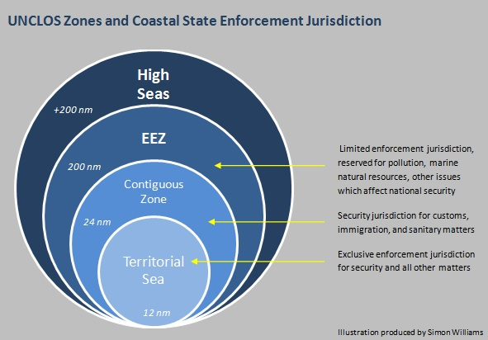
UNCLOS zones

Slide 9
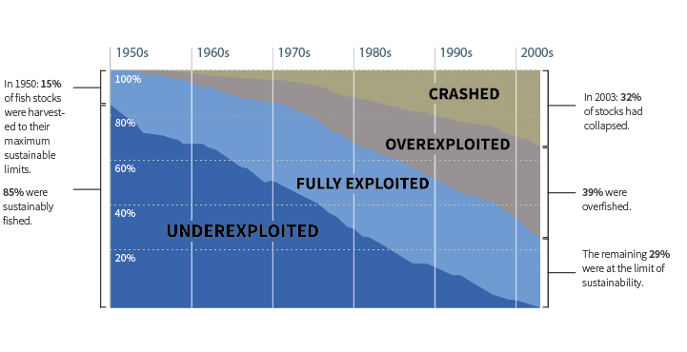
Fishing out

Slide 10
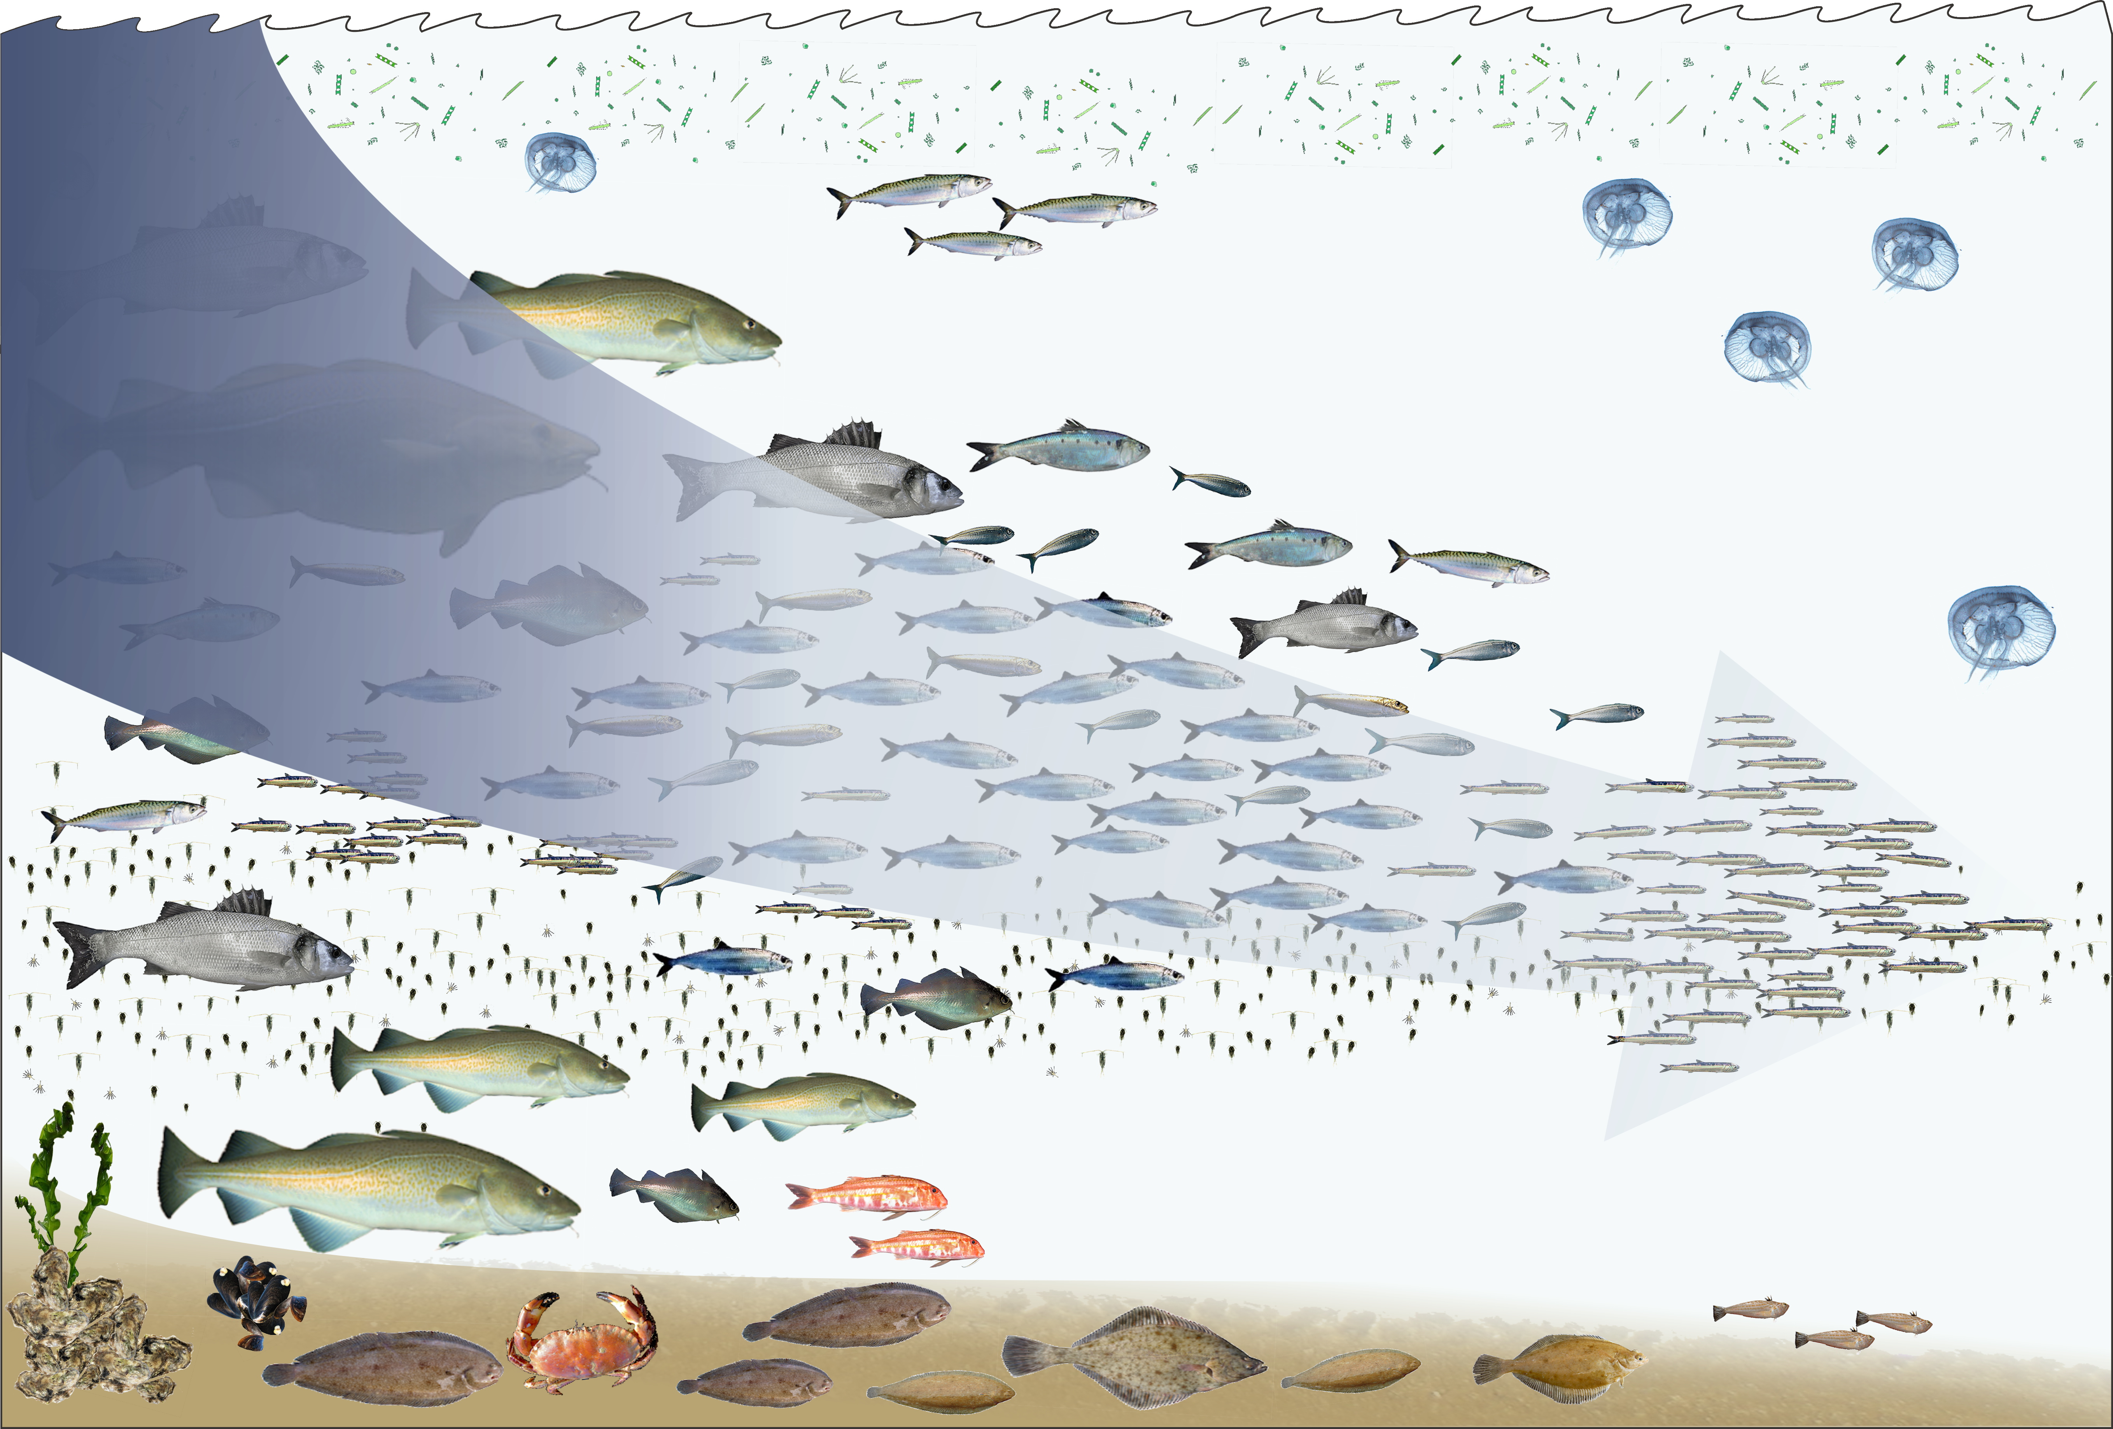
Fishing down

Slide 11
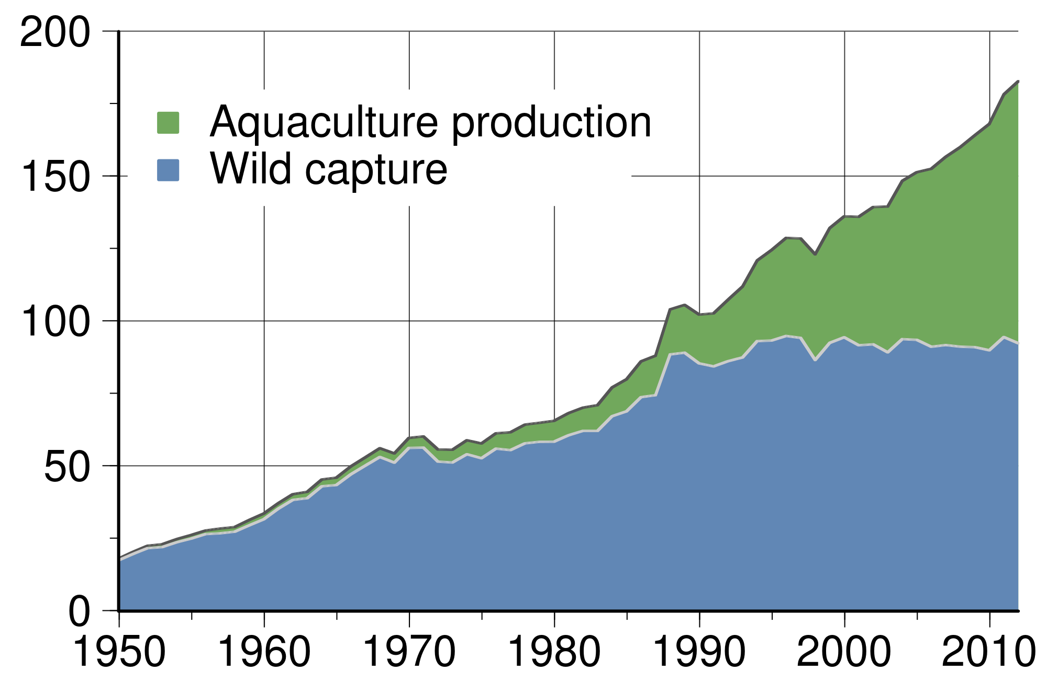
Aquaculture (1/2)

Slide 12
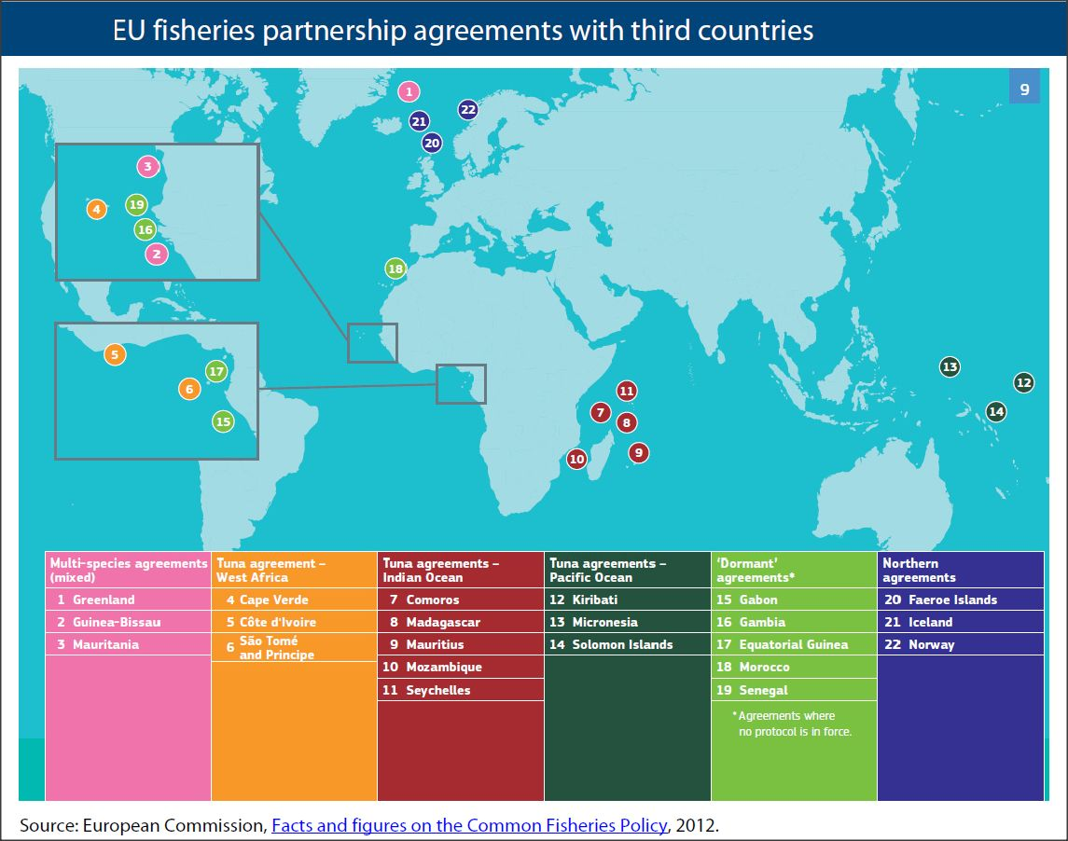
Access agreements

