Slide 1
Why Divest?
Fossil Free UNB
Christina Wilson, Kayley Reed, Richelle Martin
Notes:
Good morning ladies and gentleman. My name is Kayley Reed, this is Christina Wilson and Richelle Martin, and we are all second year Renaissance College students, as well as the co-founders of Fossil Free UNB. We’d like to start off by thanking you for inviting us to present our case on divestment from fossil fuels today.

Slide 2

Overview
Introduction
The Fossil Fuel Industry & Climate Change
Cost of Climate Change
Future Impacts in New Brunswick
Risks of Fossil Fuel Investments
Cost of Divestment
Role of Universities
UNB as a Leader in the Movement
Conclusion
Notes:
Just a brief overview of what we’ll be covering in this presentation…

Slide 3
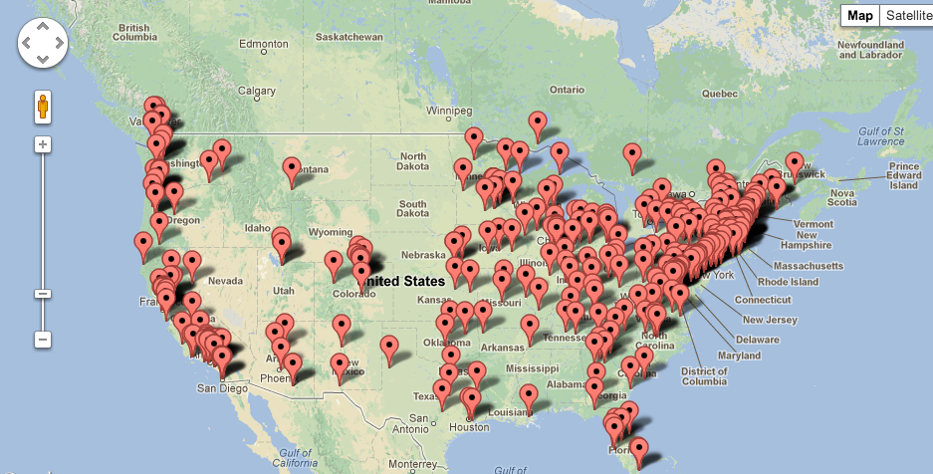
Introduction
What is Fossil Free?
Notes:
First of all, what is Fossil Free UNB and how did we become involved? Fossil Free is a student-led campaign that started in the United States only a year ago, and now has over 260 universities involved across borders. It is considered the fastest growing student campaign in history. All of these campaigns have the ultimate goal of getting their universities to divest from the fossil fuel industry. Why divest? Why is divestment important? Well in 2010 an international consensus was formed at the Cancun Agreement that we cannot surpass a 2 degree Celsius increase in global temperature.
So the Postdam Climate Institute calculated a Carbon Budget for the years 2000-2050, in attempt to manage fossil fuel burning in a way that ensures we remain below the 2 degree increase. However, by 2011 we had already used 1/3 of that budget. The Institute also calculated the amount of carbon dioxide remaining in the world’s proven fossil fuel reserves, and found a combined 2795 gt. This equates to 5 times the carbon budget for only the next 40 years. At the rate we are currently burning fossil fuels, it is predicted that in only 16 years the effects will be irreversible.
Regardless of these facts, little is being done. And that’s why the movement began. Because we – university students, young people, the next generation – are concerned for the environment, and the future of humanity., as bold as it sounds. If action isn’t taken we will literally be facing an irreversible climate catastrophe. So that’s why we’re getting involved in the most powerful way we know how – through the voice of our universities. And what is more powerful in our society than money? That’s why divestment is the focus of Fossil Free.

Slide 4

Introduction
How we became involved
What we’ve done so far
Notes:
Richelle, Christina and I specifically got involved only a couple months ago. We began the Fossil Free campaign at UNB as a leadership project for one of our classes; making UNB 1 of 12 universities in Canada involved in the movement and the first and only campaign east of Montreal. To date, we’ve gained 225 petition signatures, had articles in the Brunswickan and Daily Gleaner, presented the cause to various classes, and celebrated events at the Student Union Building like “Fossil Fools Day” to spread awareness and gain support.

Slide 5
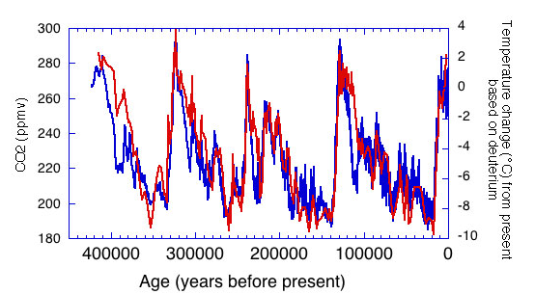
The Fossil Fuel Industry &
Climate Change
(NOAA, 2008)
Notes:
-Graph from the National Oceanic and Atmospheric Administration Agency
-Throughout our history the level of carbon dioxide has strongly correlated with temperature change. This graph ends at 1950.

Slide 6
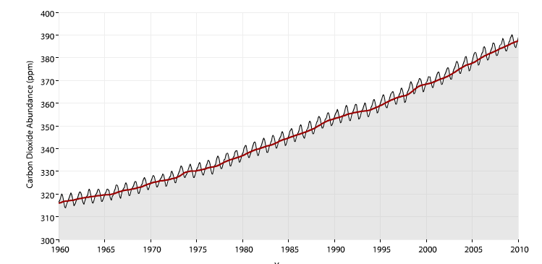
The Fossil Fuel Industry & Climate Change
(NOAA, 2009)
Notes:
-This next graph shows a more recent history where we have steadily been raising carbon dioxide emissions at a much quicker rate than in our history on this planet. Canada alone has increased emissions by 26.2% since 1990.
-Due to this increase, we are seeing, with a certain amount of inertia, a rise in our global average temperature.

Slide 7
The Fossil Fuel Industry & Climate Change
Scientists are in agreeance.. So why the public & political debate?
Millions of dollars from fossil fuel industry funding campaigns to fight solutions
“Polar bears of Western Hudson Bay and climate change: Are warming spring air temperatures the “ultimate” survival control factor?”
Notes:
-Although scientists in this field are in agreeance that the globe is warming and this warming is mainly due to large amounts of carbon being released into the atmosphere, there still seems to be public and political debate around the topic.
-This can be attributed to the hard work and hundreds of millions of dollars that the fossil fuel industry has put into funding campaigns, lobbyists, and think tanks to first reframe climate change into a theory rather than a fact and to try and block solutions or policies that would slow down the development of the industry.
-An example of this is a false article published in 2007 concluding that polar bears are not negatively affected by global warming.

Slide 8
The Cost of Climate Change
2011: record breaking year for damage due to climate related disasters
Hurricane Sandy: $75 billion
Alberta/ Saskatchewan flood of 2010: nearly $1 billion
Perth-Andover & Tobique, NB flood of 2012: over $25 million
Notes:
-Regardless of these campaigns, the rise in temp. that we are facing has lead to more frequent extreme weather events with 2011 being a record breaking year for the largest amount of damage in history due to climate related disasters.
-Hurricane Sandy cost over 75 billion dollars in damage
-The Alberta/ Saskatchewan flood of 2010 cost nearly 1 billion
-The Perthandover/ Tobique flood in NB last year cost our government over 25 million

Slide 9
Future Impacts in
New Brunswick
More severe yearly flooding
Endangerment & possible extinction of balsam fir
Increase in salt water content of Grand Lake with rising sea level
Cut in government funding for universities
Notes:
-With global warming steadily increasing with the “business as usual” model, we can expect further damage and costs in NB
-Yearly flooding will become more severe
-Within 100-150 years we will see the endangerment and possible extinction of the balsam fir in NB and the salt water content rising with rising sea level in Grand Lake
-This will cost the gov. of NB a lot of money and will leave less funding for universities in the province.
Now that I have touched on how our climate will be effected, Christina will go into detail on how our investments in the fossil fuel industry will be effected.

Slide 10
Risks of Fossil Fuel Investments
Carbon tracker
The unburnable assets
Notes:
Carbon Tracker Initiative is a project undertaken by Investor Watch, a non-profit company established by its directors to align the capital markets with efforts to tackle climate change. 2 directors of this organization include Mark Campanale (20 years experience in sustainable markets, and has served on the World Business Council for Sustainable Dev.) and Jeremy Leggett, who began his career as a constultant in the oil industry. Envtl campaigner for Greenpeace, and is currently a social entrepreneur and author).
Here are a few statements, both quoted and paraphrased, that they have recently made public about the increasing risk in investing in the industry:
Financial markets have an unlimited capacity to treat foddil fuel reserves as assets. Govts are moving toward a low-carbon economy, which is increasingly becoming a systematic risk for instituational investors. In other words, there are more fossil fuels listed on the World’s capital markets than we can afford ot burn.
Another point to consider is that we have 16 years left until the burnable carbon has been burned. As the price of oil skyrockets, the sustainable energy market will also skyrocket.
To wrap on the increasing risk of investment, it is clear that the values of endowments on fossil fuels are ridiculously inaccurate. If we burn all proven and probable oil reserves, the amount of carbon in the atmosphere will exceed 700ppm, over 2x what is considered a healthy level.
The article that was sent out to you was a study conducted by Aperio. They are a management consulting firm that works exclusively with organizations (private and not-for-profit) that have a social purpose. Their findings demonstrate that although there was a small risk and there were in fact losses on investment profits, they were so small that they could be considered insignificant. Furthermore, it is important to note that they encompassed a larger sector of divestment than our focus, this argument that large losses will occur then becomes invalid.

Slide 11
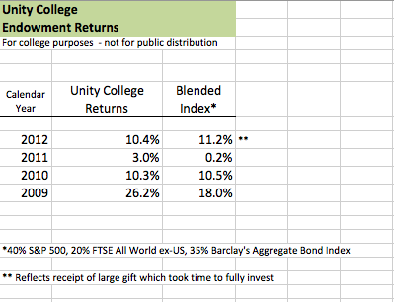
Cost of Divestment
Aperio Group Study: Divestment costs little to nothing
Unity College Maine
Vancity
Notes:
2 days ago, I had the privilege of speaking with the Associate Director of College Communications of Unity College, the first college in North America to divest from Fossil Fuels. We discussed the movement for quite some time, but if I took anything away, it was the bold statement made that the university, has not lost profits on investments since the change was made. As this graph clearly demonstrates, their return on endowments have increased yearly.
The first note explains the blended index – it is how “the market” did that year as a point of comparison/benchmark.
The second note explains that Unity College received a large cash gift in late 2011 – it took several months to fully invest it in the market, so they had more cash on hand, consequently earning a lower return than usual in 2012.

Slide 12
The Role of Universities
A beacon for society
Individual action no longer has a large enough impact
Ability to send a powerful message
Provide a way for students to get involved and make a difference
The responsibility of educational institutions in supporting the best future possible for students
Notes:
-Universities are a beacon for society and are the place where problems of today and tomorrow are solved.
-We are now finding ourselves in a situation where our lives revolve around fossil fuels and our policies are protecting them and this lifestyle, yet if we even burn 1/5 of the proven reserves then we will be putting not only our environment at great risk but the future of our own species.
-This is a huge problem, because no matter how hard one wants to live an ecofriendly life, free of fossil fuels, there is just no option to do so. It is true that as individuals we can cut back on our carbon footprint by taking shorter showers, carpooling, buying second hand clothes, etc. but we are at a point now that these actions will realistically make no difference.
-What will make a difference though, are large scale movements such as this fossil free movement where universities who have the knowledge, have the credibility, and have the support of the younger generation, can stand up together and send a powerful message that we cannot continue with a business as usual model.
-This movement will allow for students across Canada to get involved in policy issues that are relevant to them and to create political space resulting in a powerful voice.
-Educational institutions have a special responsibility in the climate change movement because they are the ones who are educating and preparing our next generation to take leadership roles in society.
-This means that they have an obligation to not be invested in the companies that will be severely harming the environment that these leaders will be working in, and fueling the problems that these leaders will have to face.

Slide 13

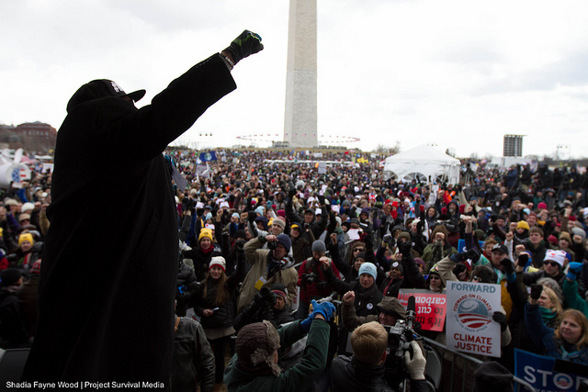
Impact Universities Have
Anti Apartheid Movement
http://www.sgiquarterly.org/feature2005Apr-2.html
www.350.org
Notes:
You may be asking yo0urselves: why target universities? We're in fact following in the footsteps of students involved in a similar movement in the 1980s, concerning the anti-apartheid movement in South Africa. Students in over 150 North American universities protested against university endowments in companies with relation to South African labour and rejecting the SA government supporting the apartheid. This movement urged policymakers to take notice, which they did, eventually turning the campaign and movement into a huge success.
For the same reasons we are. Higher education institutions are a repository for sharing, gathering and discovering new information and knowledge. They hold the latest research and scientific evidence with regards to climate change and the planet's current status. If these institutions holding the latest facts and findings are not willing to take a stand with proved evidence at their fingertips, and cannot uphold what it puts forth into the world: innovation, leadership, problem-solving and progress, why would policy-makers, far less tied to these research systems, take the issues at hand seriously enough to make a significant difference?

Slide 14
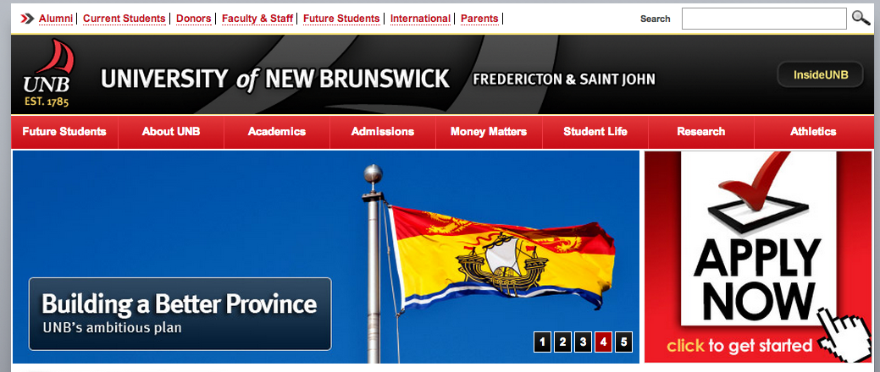
UNB as a Leader in the Movement
1st Canadian university to divest
“Why UNB?” campaign
Notes:
We have an opportunity to be a leader in this movement. If divestment is agreed upon, we would be the first university in Canada to do so. A commitment like that would speak volumes to the kind of institution UNB is, and would fit perfectly as a case for recruitment. “Why UNB?” Because not only are we a leader in this sector, we produce leaders in all fields who take on these problems of today, and tomorrow. Sound familiar?

Slide 15
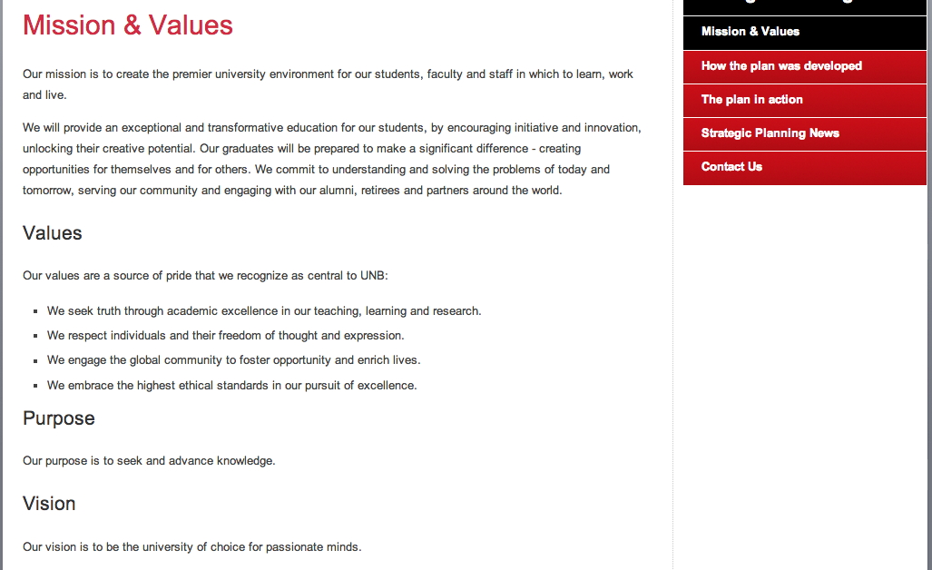
It All Aligns
Notes:
Our entire campaign aligns with the Mission & Values of UNB. From “encouraging innovation” to “engaging in the global community”. We CAN walk the talk.

Slide 16

Conclusion
Notes:
Divestment is considered the most powerful statement an institution can make with its money – and in our society, money talks, giving the divestment movement a powerful voice.
So as students, leaders of tomorrow, and future parents, we are asking you to please put an end to the apathy, and take a stand on climate change. Consider divesting, not only for the future of the environment, and global community, but also for the future of UNB and your own grandchildren.
Thank-you.

